Slide 1
Effect of Educational Attainment on per Capita Growth by State
Vicky, Adrianna, Jared, Liliya, Yousief

Slide 2
Selection of Topic
We have taken on the challenge to dissect the impact education has on per capita growth year over year on state level. The goal of our proposed question is to identify trends by state, region and/or education.
Collectively we hope to identify the indicators of monetary impact by educational attainment by state.

Slide 3


Data Source
Per Capita Income by State
Bureau of Economic Analysis: Regional Economic Accounts, Personal Income (State and Local), Annual Personal Income and Employment by State
https://apps.bea.gov/regional/downloadzip.cfm, SAINC5N_ALLAREAS_1998_2020.csv
Educational attainment
Census.gov: American Community Survey, Selected Social Characteristics in the United States,
https://data.census.gov/cedsci/table?q=DP02&g=0100000US%240400000&tid=ACSDP1Y2019.DP02

Slide 4
Questions to answer with the analysis:
The impact education has on per capita growth year over year in each state.
Will there be notable patterns?
Are there patterns between states?
Are there patterns between regions?
Are there outliers?
If so, which state or education attainment?

Slide 5
Data Exploration
Finding Key Features was the first step:
Education Levels:
- Less than 9th grade -9th to 12th grade - High School -Some College
-Associate’s Degree -Bachelor’s Degree - Graduate Degree
Dependent Variable/Target:
Per Capita Income

Slide 6
Data Exploration
Pulling all data to CSV file to determine which available features were going to be used in analysis
API pull of data from census.gov website for years 2005 - 2019
API pull varied between the years 2005 - 2007 to 2008 -2019 due to website and survey reconstruction
Download and preprocessing of per capita income by state from BEA website
Preprocessing in Jupyter Notebook:
Removing columns and rows deemed unnecessary in order to read data.
Converting objects to strings
Reordering columns
Plotting data to help determine the patterns to dive in deeper

Slide 7
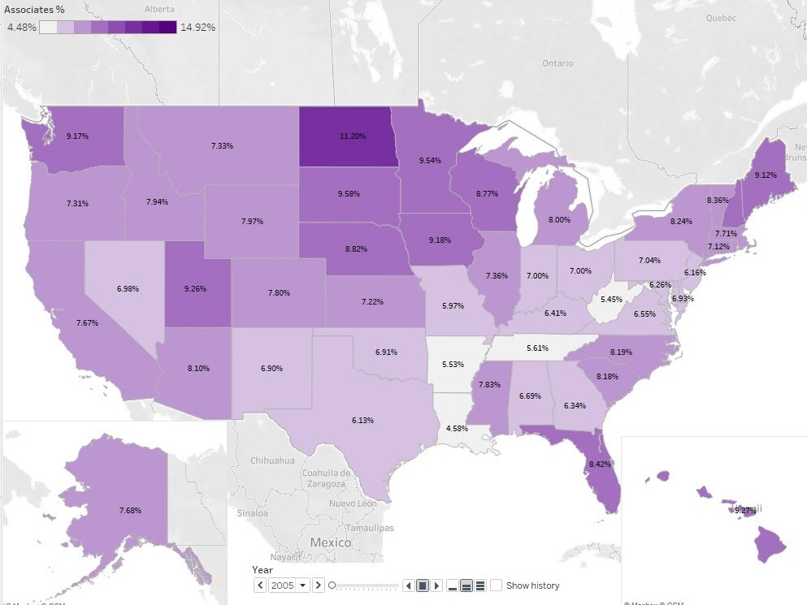
Data Visualization - Tableau
https://public.tableau.com/app/profile/vicky.carlson/viz/EffectofEducationalAttainmentonPerCapitaIncomeGrowth/Story1

Slide 8
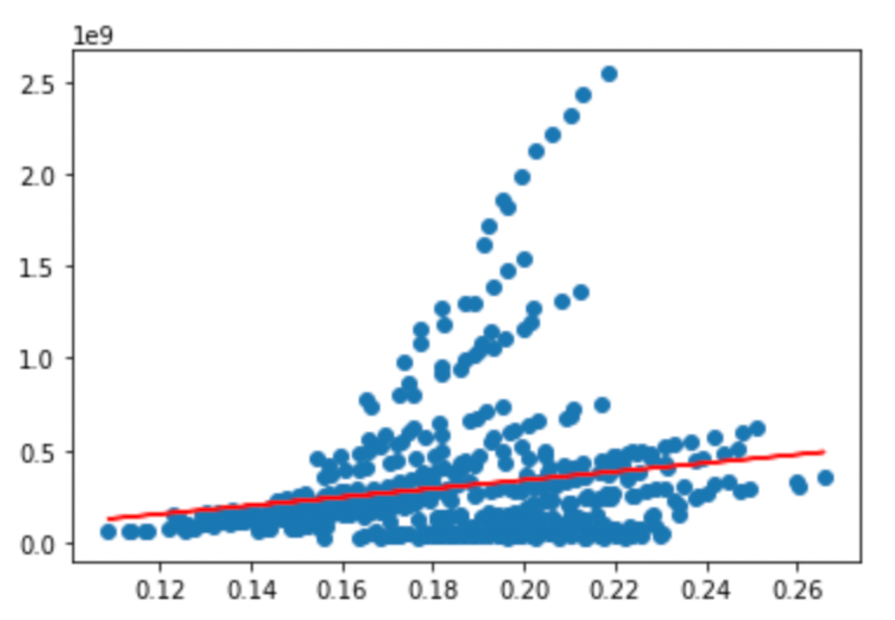
Analysis - Linear Regression
A positive linear regression relationship is observed with some outliers to identify further.
From the linear regression we were able to attain below metrics:
R2
Coefficients
Intercept

Slide 9
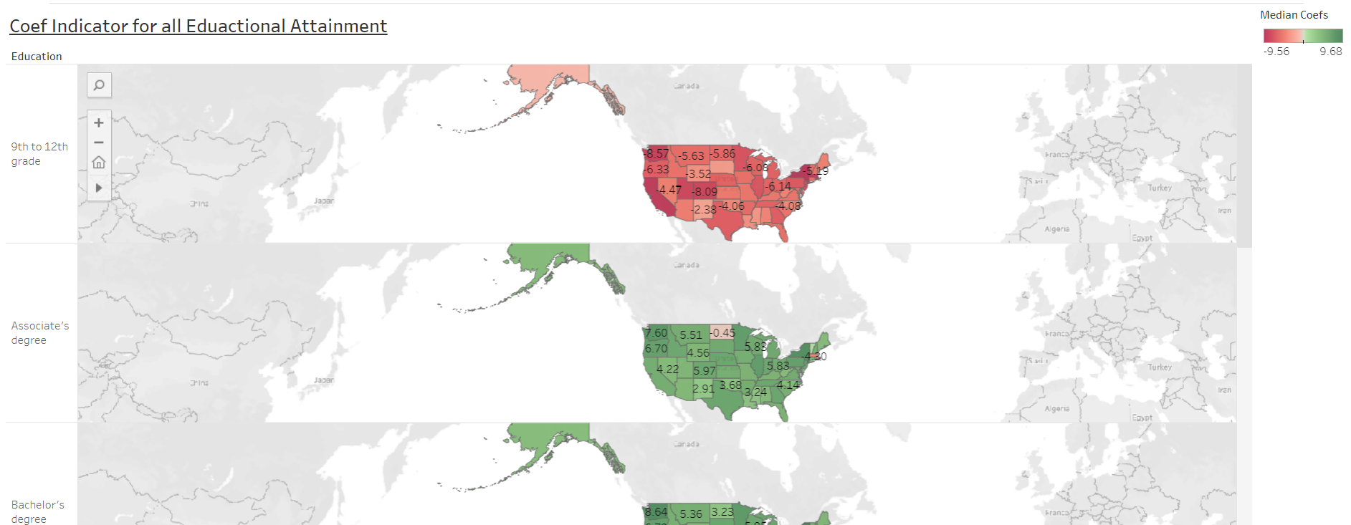
Data Visualization - Tableau
https://public.tableau.com/app/profile/yousief.beyene/viz/CoefIndicatorofalleducationalattainments/Sheet1

Slide 10
Analysis - Machine Learning
SKLearn Linear regression model to train regressions.
First Model measured the association between seven levels of educational attainment and income, excluding state data specification
Second Model each state and each level of education type correlation to income for each state
Third Model combined models of education and income for each state
All models yielded the data, R2 , intercept and slope are outputted in JSON-like format used for further analysis and modeling.

Slide 11
Analysis - Machine Learning

Slide 12
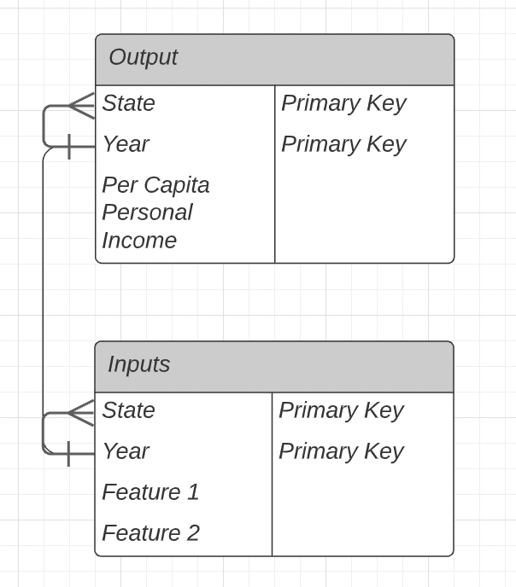

Databases
Two tables:
Input
Output
Machine Learning Results

Slide 13
Result of analysis
Directionality, outline states, outling education level bachelors 9-12 graduate, model that works what we found is robust.
[Insert Heat Map updated version]

Slide 14
Recommendation for future analysis
Focus in on the Outliers Montana, Louisiana and Alaska Nevada
Split data further gender, race migrant population, age
Expand Machine Learning Model
Other impact on per capita income - Primary Industries by state, industry performance
Geographical income

Slide 15
Anything that would be done differently
Dive in deeper
Structure output as csv instead of JSON
Go further back on the data years

Slide 16
Technologies, Languages, Tools and Libraries
Python 3.7.11
Pandas 1.3.5
Requests 2.26.0
Census Data 1.15
Pathlib 2.3.6
Matplotlib 3.5.0
Sklearn 1.0
Jupyter 1.0
pgAdmin 5.7
PostgreSQL
Tableau Desktop 20.4.2
Tableau Public
Microsoft Excel
Google Drive, Docs, Slides

